Slide 1
R Stats Bootcamp 10
Regression Ed Harris/Megan Lewis

Slide 2


Slide 3

R Stats Bootcamp
R Stats Bootcamp 10
We should be suspicious if the data points all fall exactly on the straight line of prediction

Slide 4
Regression to the mean
“The general rule is straightforward but has surprising consequences: whenever the correlation between two scores is imperfect, there will be regression to the mean.”
– Francis Galton

Slide 5
Objectives
The question of simple regression
Data and Assumptions
Graphing
Tests and Alternatives
Practice exercises

Slide 6
The question of simple regression
Relating the value of a numeric variable to that of another variable
Predict the value of the variable
Quantify variation
Quantify degree of change
Null hypothesis significance testing

Slide 7
A few definitions
Classic linear regression
$$y_{i}=α+βx_{i}+ε_{i}$$
Regression parameters: $α$ (alpha, intercept) and $β$ (beta, slope)
Dependent ($y$) and predictor ($x$) variables
Residual error $ε$ (epsilon)

Slide 8
A few definitions continued…
Assumption of residual error
$$ε_{i} Gaussian\left(0,σ^{2}\right)$$
Gaussian with mean of 0 and variance estimated with our model
Sum of squares (SS) error for the residuals
$$SS_{res}=∑ _{i}^{n} {\left(y_{i}−\left(α+βx_{i}\right)\right)}^{2}$$
$\overset{‾}{x}$ or $\overset{‾}{y}$ is the sample mean
The variance of residuals is the $ $ where n = sample size.

Slide 9
A few definitions continued…
Estimate of the slope
$$\hat{β}=\frac{∑\left(x_{i}−\overset{‾}{x}\right)\left(y_{i}−\overset{‾}{y}\right)}{∑{\left(x_{i}−\overset{‾}{x}\right)}^{2}}$$
Estimate of the intercept
$$\hat{α}=\overset{‾}{y}−\hat{β}\overset{‾}{x}$$

Slide 10
Data and Assumptions
Linear relationship
Numeric continuous data for y
Can be numeric ordinal for predictor variable
Independent observations
Gaussian distribution of residuals
Not the same as assuming the raw data is Gaussian!
Homoscedasticity

Slide 11
Off to R!
Simple regression model with the Kaggle fish market dataset

Slide 12
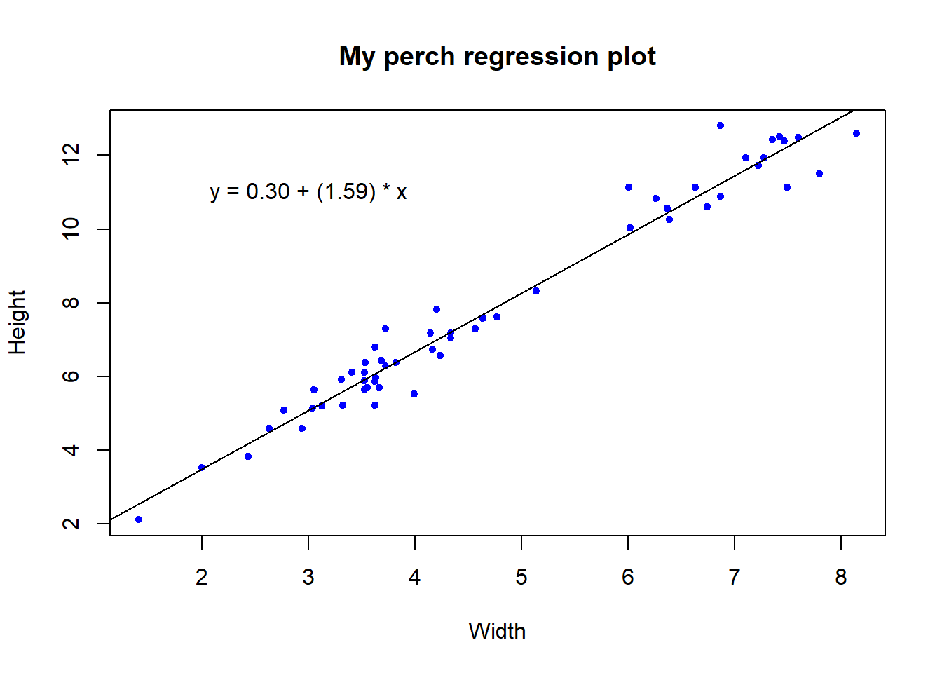
Graphing
Scatterplot
Independent (predictor) variable on x-axis
Dependent variable on y-axis
Regression equation to estimate line of best fit for sample data
Prediction

Slide 13
Off to R!
Add a regression line to a plot!

Slide 14
Testing the assumptions
Part of exploratory data anlysis (EDA)
Validating the statistical model
Subjective and subtle
Can be difficult at first

Slide 15
Off to R!
Visualize the residuals
Check the Gaussian assumption
A closer look at the residual distribution
Shapiro-Wilk test of normality
Diagnostic plots and heteroscedasticity

Slide 16
Reporting results
E.g., “We found a significant linear relationship for [independent (predictor) variable] predicting [dependent variable] in [study system] (regression: R-squared = 0.97, df = 1, 54, P<0.0001).
Appropriate graph
Relevant in context of other results

Slide 17
Alternatives to regression
Large number
Quite advanced & beyond scope of the bootcamp
Reasonable solutions:
Data transformation
Spearman’s rank correlation
Non-parametric regression - e.g., Kendall-Theil-Sen

Slide 18

Practice Exercises

